Slide 1
Smart Water Management: The Future of Agriculture with Automatic Irrigation
BY
SANJAY C

Slide 2
OBJECTIVE
The primary objective of this project is to create a sophisticated automatic irrigation system using an Arduino ESP8266 microcontroller board.
Develop a system that intelligently manages water resources by delivering the right amount of water to plants based on their specific needs.
Implement features that promote plant health and growth. The system should be capable of adjusting watering schedules, duration, and frequency to cater to different types of plants and their growth stages.
Design a user-friendly interface for setting up and configuring the irrigation system.
Create a cost-effective solution that minimizes water wastage and reduces the need for manual labor in maintaining the irrigation process.

Slide 3
PROBLEM STATEMENT
The problem of automatic irrigation aims to develop a system that efficiently manages the watering of plants in agricultural settings.
This system must address several challenges, including optimizing water usage, monitoring soil moisture levels, and ensuring timely irrigation based on environmental conditions.
PROJECT STATEMENT
This project will integrate cutting-edge sensor technology to continuously monitor soil moisture levels, weather conditions, and other environmental factors.
This project also emphasizes sustainability by reducing water wastage and promoting responsible irrigation practices. Users will have the convenience of remotely monitoring.

Slide 4
IoT SENSOR DESIGN
By integrating sensors like soil moisture, temperature, humidity, and rain detectors, Arduino empowers these systems to collect real-time environmental data critical for optimal irrigation decisions.
Moreover, Arduino's compatibility with various communication modules and its active open-source community ensure that it remains a go-to choice, offering accessibility, expandability, and ease of customization in the development of efficient and user-friendly automatic irrigation systems.

Slide 5
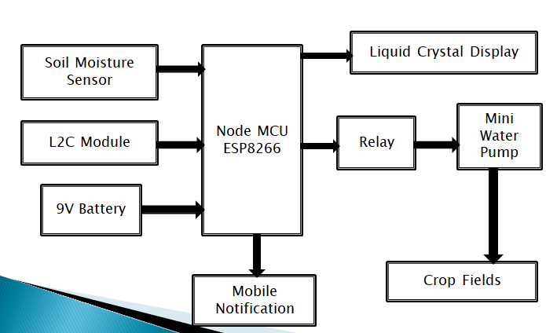
BLOCK DIAGRAM

Slide 6
INPUT MODULE
SOIL MOISURE SENSOR: The soil moisture sensor (SMS) is a sensor connected to an irrigation system controller that measures soil moisture content in the active root zone before each scheduled irrigation event and bypasses the cycle if soil moisture is above a user- defined set point.
L2C MODULE: It is a bus interface connection protocol incorporated into devices for serial communication. It was originally designed by Philips Semiconductor in 1982.
BATTERY: A battery is a source of electric power consisting of one or more electrochemical cells with external connections for powering electrical devices.

Slide 7
NODEMCU ESP8266
Ai Thinker NodeMCU-ESP8266 is an open-source firmware and development kit that helps you to prototype or build IoT products.
It includes firmware that runs on the ESP8266 Wi-Fi SoC from Espressif Systems, and hardware which is based on the ESP-12 module.

Slide 8
OUTPUT MODULE
LCD: LCD (Liquid Crystal Display) is a type of flat panel display which uses liquid crystals in its primary form of operation. LEDs have a large and varying set of use cases for consumers and businesses, as they can be commonly found in smartphones, televisions, computer monitors and instrument panels.
MOBILE DISPLAY: We can display the results in BLYNK app using mobile phones.
CROP FIELDS AND WATER PUMPS: Automatic irrigation is the use of a device to operate irrigation structures so the change of flow of water from bays can occur in the absence of the irrigator.

Slide 9
CODE
import machine
import network
import time
ssid = 'YourNetworkSSID‘
password = 'YourNetworkPassword‘
sta_if = network.WLAN(network.STA_IF)
sta_if.active(True)
sta_if.connect(ssid, password)
moisture_sensor_pin = machine.Pin(14, machine.Pin.IN)
pump_pin = machine.Pin(12, machine.Pin.OUT)
moisture_threshold = 50
def water_plants():
pump_pin.on()
time.sleep(10)
pump_pin.off()
while True:
moisture = moisture_sensor_pin.value()
if moisture < moisture_threshold:
water_plants()
time.sleep(3600)

Slide 10
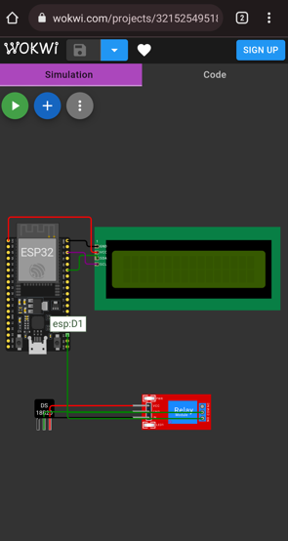


Slide 11
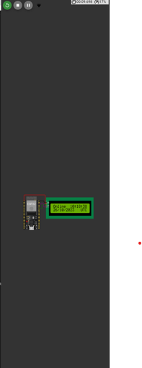

Slide 12
OUTPUT VERIFICATION
The data collected from sensors is then transmitted to a centralized database for real-time analysis.
Users gain access to these insights through user-friendly interfaces and manual adjustments.
This platform offers precision, scalability, and adaptability, ultimately contributing to healthier plants, improved crop yields, and responsible resource management.

Slide 13
CONCLUSION
The data collected from sensors is then transmitted to a centralized database for real-time analysis.
Users gain access to these insights through user-friendly interfaces and manual adjustments.
This platform offers precision, scalability, and adaptability, ultimately contributing to healthier plants, improved crop yields, and responsible resource management.

